Slide 1
VISUAL C#.NET session 21
Instructor: Edwin oduor

Slide 2

Quote of the day

Slide 3
Lesson objectives
Performing CRUD Operations

Slide 4
Lesson pre-requisites
In order to take full advantage of this section you need to have the following;
Computer with Visual Studio Installed.
Stable Network Connection.

Slide 5
Training methods and extra readings
TRAINING METHODS FOR THIS LESSON
EXTRA READINGS
Lecturing Method – This is the main method of training to be adopted in this lesson with illustrations and practical coding examples.
Discussion Method - This method will be adopted periodically whereby learning will be derived principally from the students brainstorming together, rather than from the trainer. Three main types of discussions will be used:
Directed discussion
Developmental discussion
Problem-Solving discussion
Home and Learn C#

Slide 6
Performing crud operations

Slide 7
What is crud?

Slide 8
CRUD is short form of CREATE
READ
UPDATE &
DELETE
In this session will be learning how to perform the above mentioned.

Slide 9
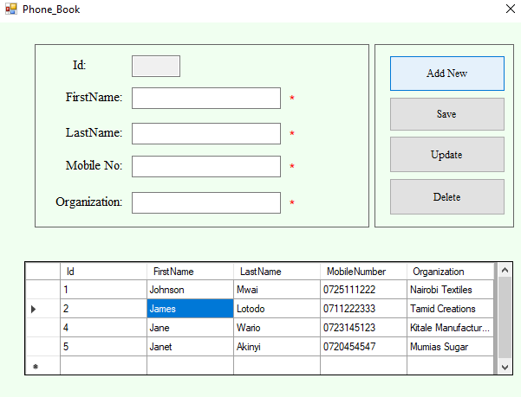
When Add New Button is clicked on then the system will clear all the contents that are being displayed in the textbox.

Slide 10
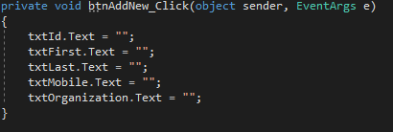
This is the code for the add new button.
Once the add new button has been clicked on then one can type inside the textboxes to add a new record.

Slide 11
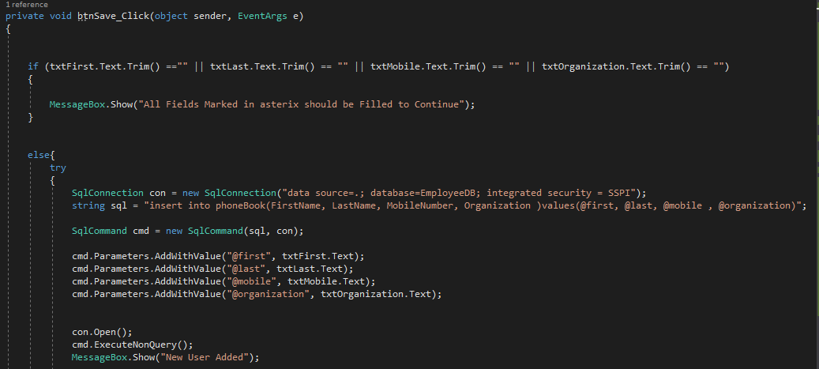
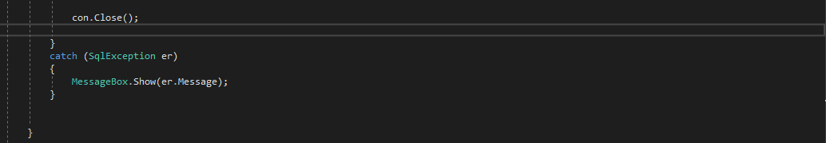
When the save button is clicked, the records that have been typed in the text boxes are going to be saved in the database. Code for the save Button.

Slide 12
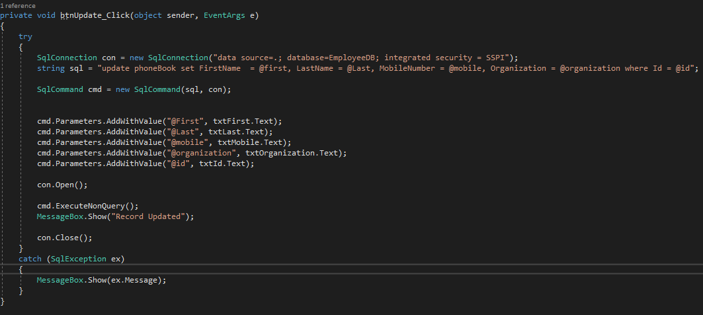
When one wants to update records that are already in the database, then one will click on the record in the data grid then type the record to update in the text boxes and lastly click on update the records will be updated in the database. Code for update.

Slide 13
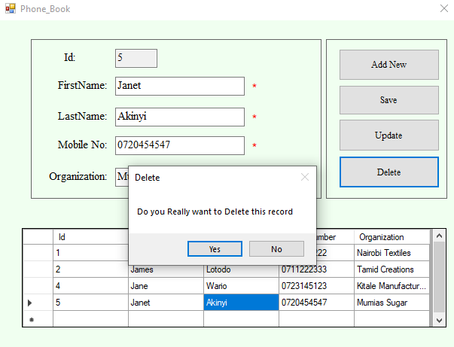
The Delete Button, when clicked will ask if one really wants to delete the record if the user confirms that they want to delete then the record is going to be deleted but on the other hand if one says that they don’t want to delete the record then the delete is going to be cancelled.

Slide 14
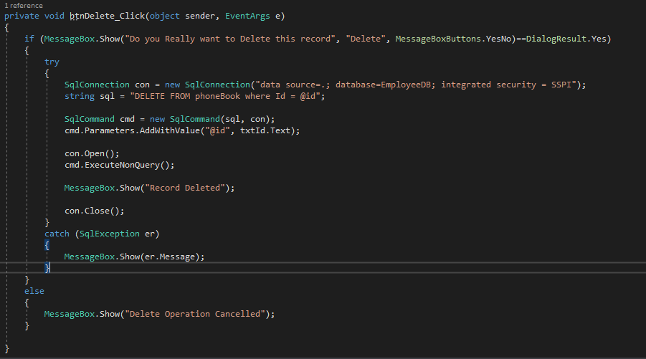
Code for Delete

